Slide 1
Travel Planner Agent
CAPSTONE PROJECT
Presented By : DIVYA DS
Student name: DIVYA DS
College Name: Sri Krishna Institute Of Technology Department : Information Science and Engineering

Slide 2
OUTLINE
Problem Statement
Technology used
Wow factor
End users
Result
Conclusion
Future scope
IBM Certifications
Git-hub Link

Slide 3
Problem Statement
Problem Statement:
Planning a trip involves multiple fragmented tasks—choosing destinations, checking weather, comparing transport and accommodation, and creating an itinerary—all of which are time-consuming and often impersonal. Users struggle to find a unified platform that considers their preferences, budgets, and real-time factors.
Proposed Solution:
The Travel Planner Agent is an AI-powered assistant that uses IBM Cloud Lite services and IBM Granite to automate and personalize trip planning. It intelligently suggests destinations, builds custom itineraries, integrates real-time weather and maps, recommends transport and stay options, and even manages travel alerts. This makes travel planning fast, efficient, and user-centric.

Slide 4
Technology used
IBM Cloud Lite services
IBM Watson Assistant
Node.js or Python (backend)
HTML / React.js (frontend)
IBM Granite or Prompt Lab (if used)

Slide 5
IBM cloud services used
IBM Cloud Watsonx AI Studio
IBM Cloud Watsonx AI runtime
IBM Cloud Agent Lab
IBM Granite foundation model

Slide 6
Wow factors
Personalized trip planning based on real-time weather, budget, and preferences
Auto-generated itineraries with travel and stay suggestions
Live updates on weather, route, and cost
Integration with map APIs for visual planning
Multi-language support for native travelers
Travel alerts and optimization on the go

Slide 7
End users
Solo travelers
Tourists
Travel agencies
Students or working professionals planning trips
Corporate travel departments

Slide 8
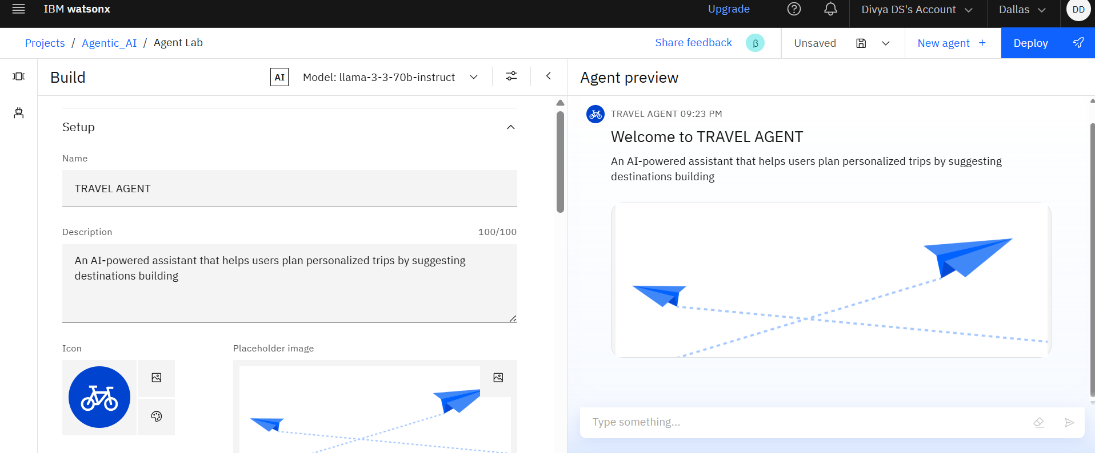
Results

Slide 9
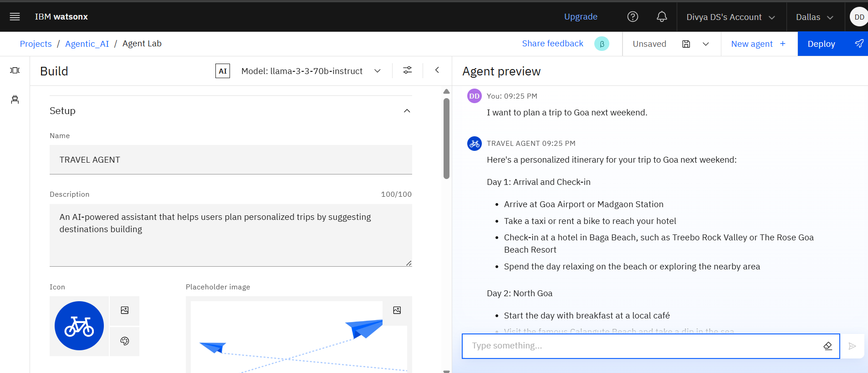
Results

Slide 10
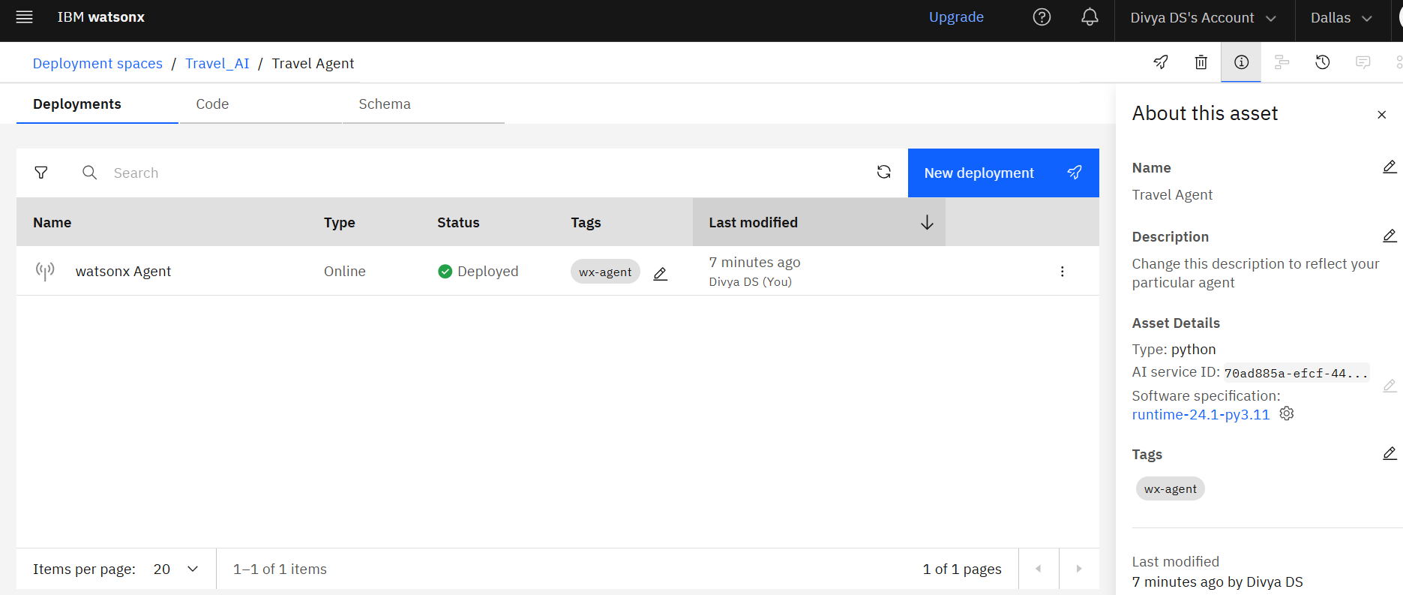
Results

Slide 11
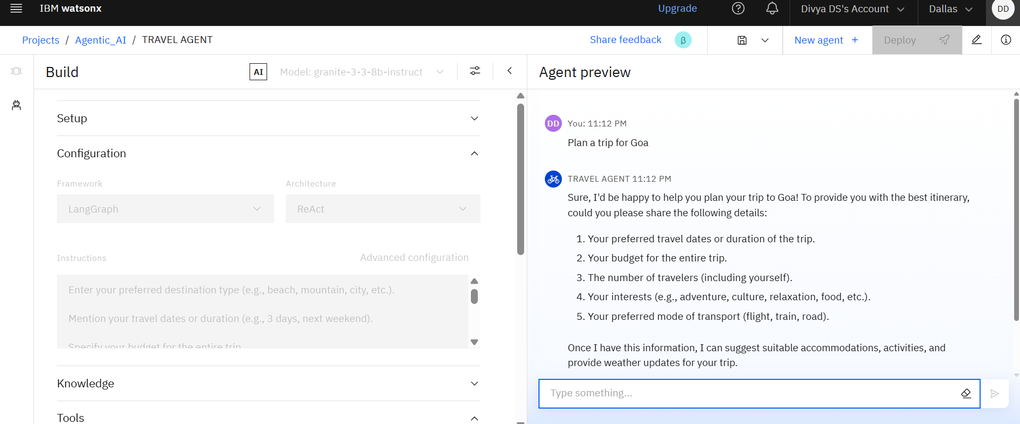
Results

Slide 12
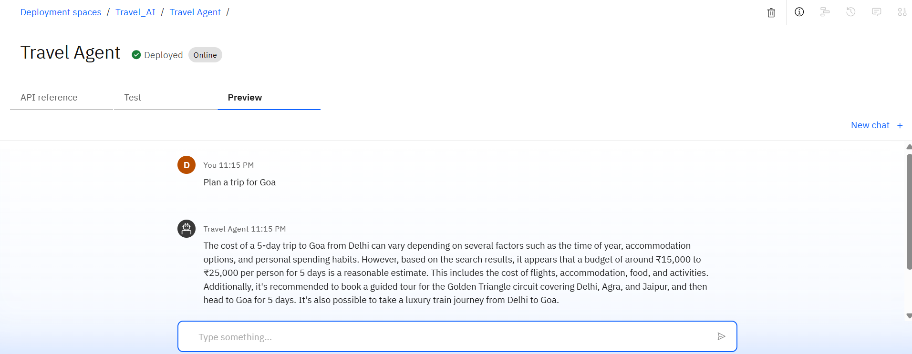
Results Deployed AI Agent

Slide 13
Conclusion
The Travel Planner Agent successfully demonstrates how AI can simplify and enhance the travel planning experience. By leveraging IBM Cloud Lite services and foundation models like IBM Granite, the agent provides users with personalized, real-time travel suggestions, complete itineraries, and relevant weather and accommodation data. It reduces manual effort, saves time, and offers a seamless, user-friendly interface for planning trips.
The agent’s modular design allows easy integration of new features like voice-based interaction, multilingual support, and real-time booking. As a smart assistant, it bridges the gap between user intent and actionable travel plans, making it a valuable tool for both casual travelers and professional planners.

Slide 14
Future scope
Full booking system (flights, hotels, cabs)
Voice assistant integration
Offline itinerary generation
Travel document and visa assistant
Smart budget optimizer
More language support (Kannada, Hindi, etc.)

Slide 15
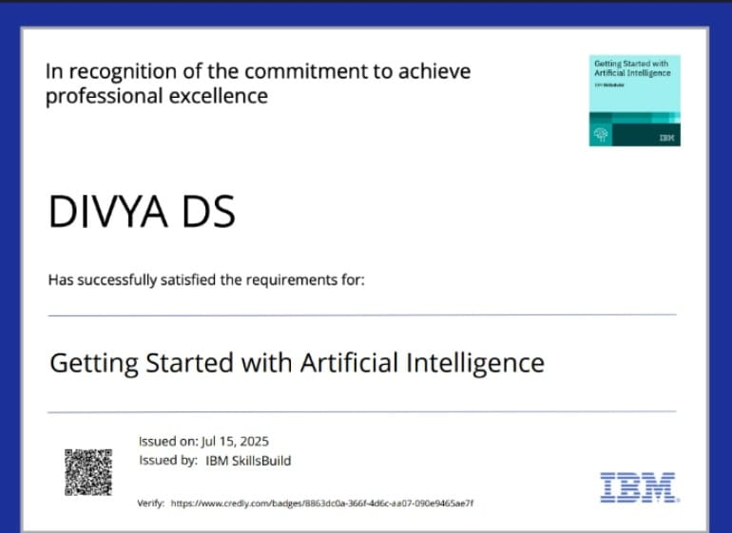
IBM Certifications

Slide 16
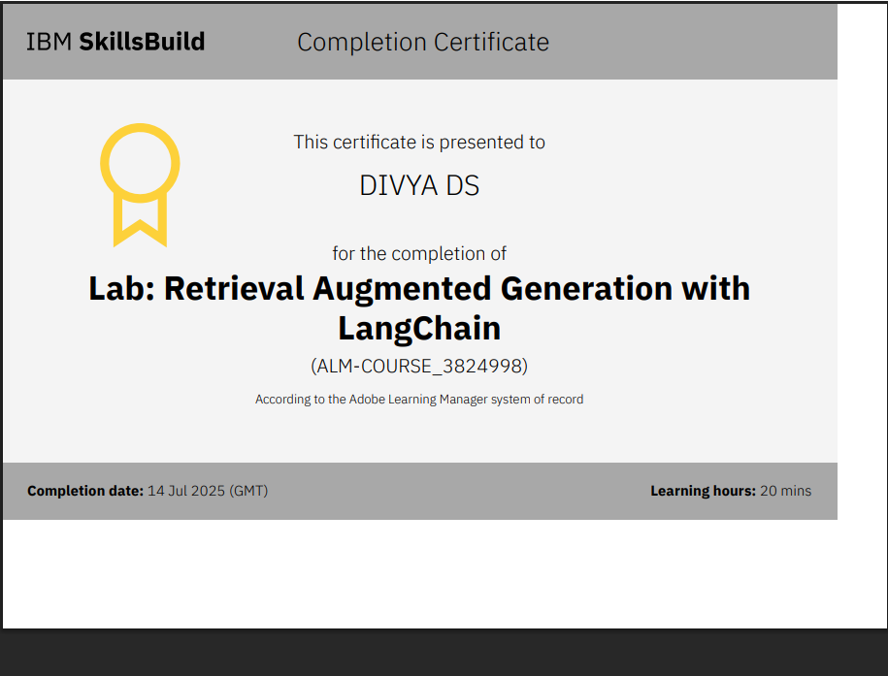

Slide 17


Slide 18
GitHub Link
https://github.com/Divya-ds21/Travel_AI-Agent.git

Slide 19
THANK YOU

